Slide 1
KYTC Mission
To provide a safe, efficient, environmentally sound and fiscally responsible transportation system that delivers economic opportunity and enhances the quality of life in Kentucky.
To provide a safe, efficient, environmentally sound and fiscally responsible transportation system that delivers economic opportunity and enhances the quality of life in Kentucky.
To provide a safe, efficient, environmentally sound and fiscally responsible transportation system that delivers economic opportunity and enhances the quality of life in Kentucky.

Slide 2


2017 KYTC Partnering
“Have you been FLEXed,
Who’s Next?”
HURSTBOURNE PARKWAY
5-344.01
“We’re here to FLEX you up!”

Slide 3
LOCATION MAP

Slide 4
PROJECT HISTORY
2003 – 2005: Original project to widen the southbound lane from Linn Station to Shelbyville Road (US 60).
2005: Due to high crash rates, Shelbyville Road intersection was added as a Hazard Elimination and Safety Program (HES) project.
2005 – 2007: Access management was added and carried through PL&G. A preferred alternate was selected.
2009: Practical Solutions were considered and implemented including reduced lane width, reduced border width, remove curb and gutter in some median areas, remove right turn lanes and remove west side sidewalks.
2009 – 2016: On hold due to funding and local officials prioritization/buy-in.

Slide 5
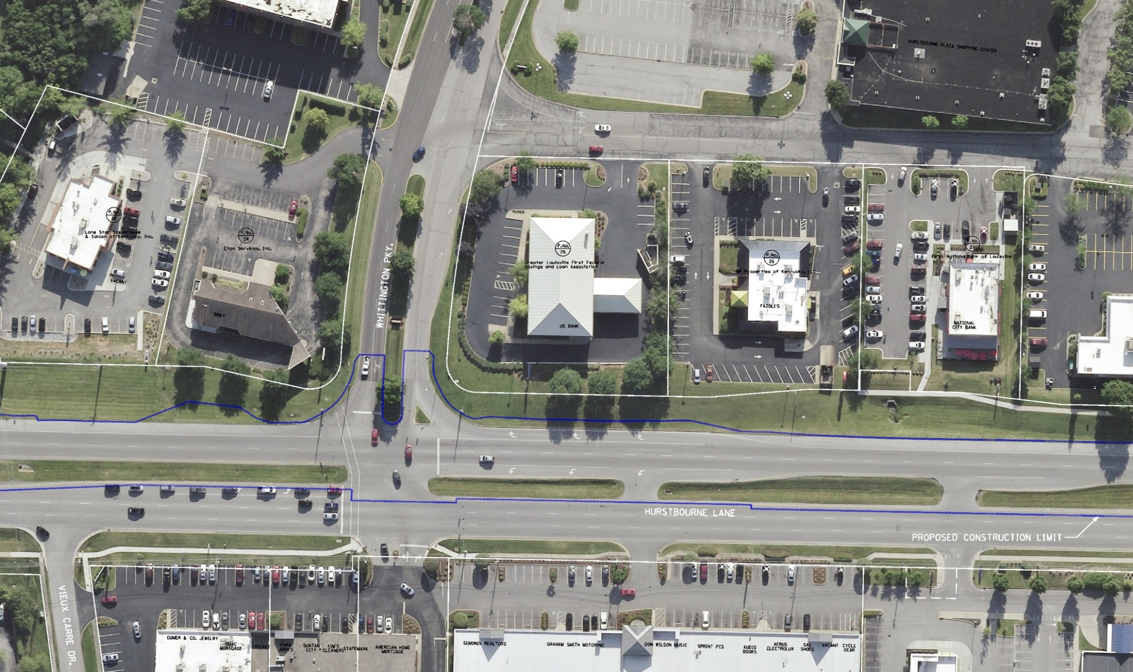
EXISTING CONDITIONS
EXISTING RURAL TYPICAL SECTION
FULLY DEVELOPED PROJECT AREA
WIDE EXISTING RIGHT OF WAY (165’ +)

Slide 6
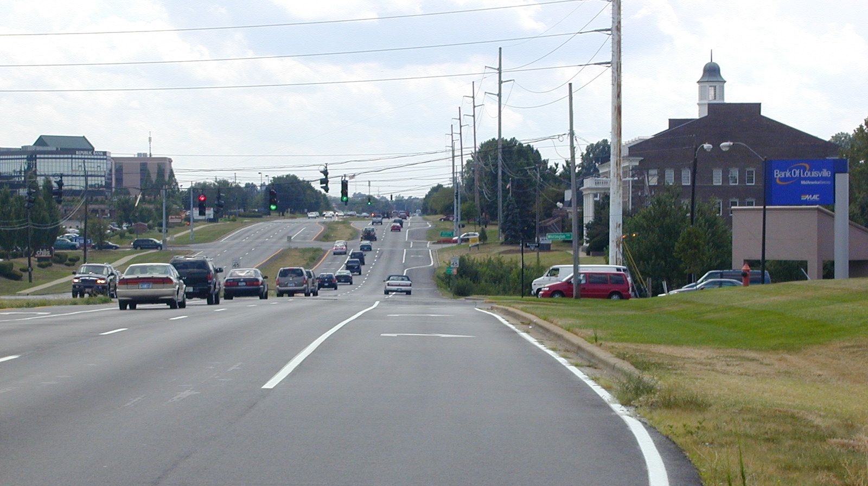
EXISTING CONDITIONS

Slide 7
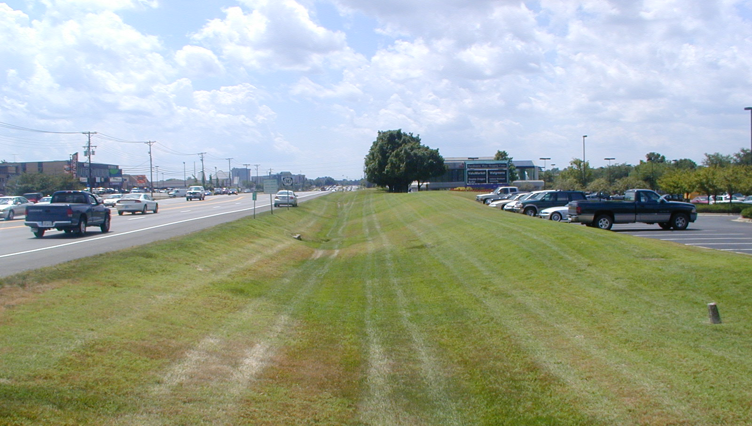
EXISTING CONDITIONS

Slide 8
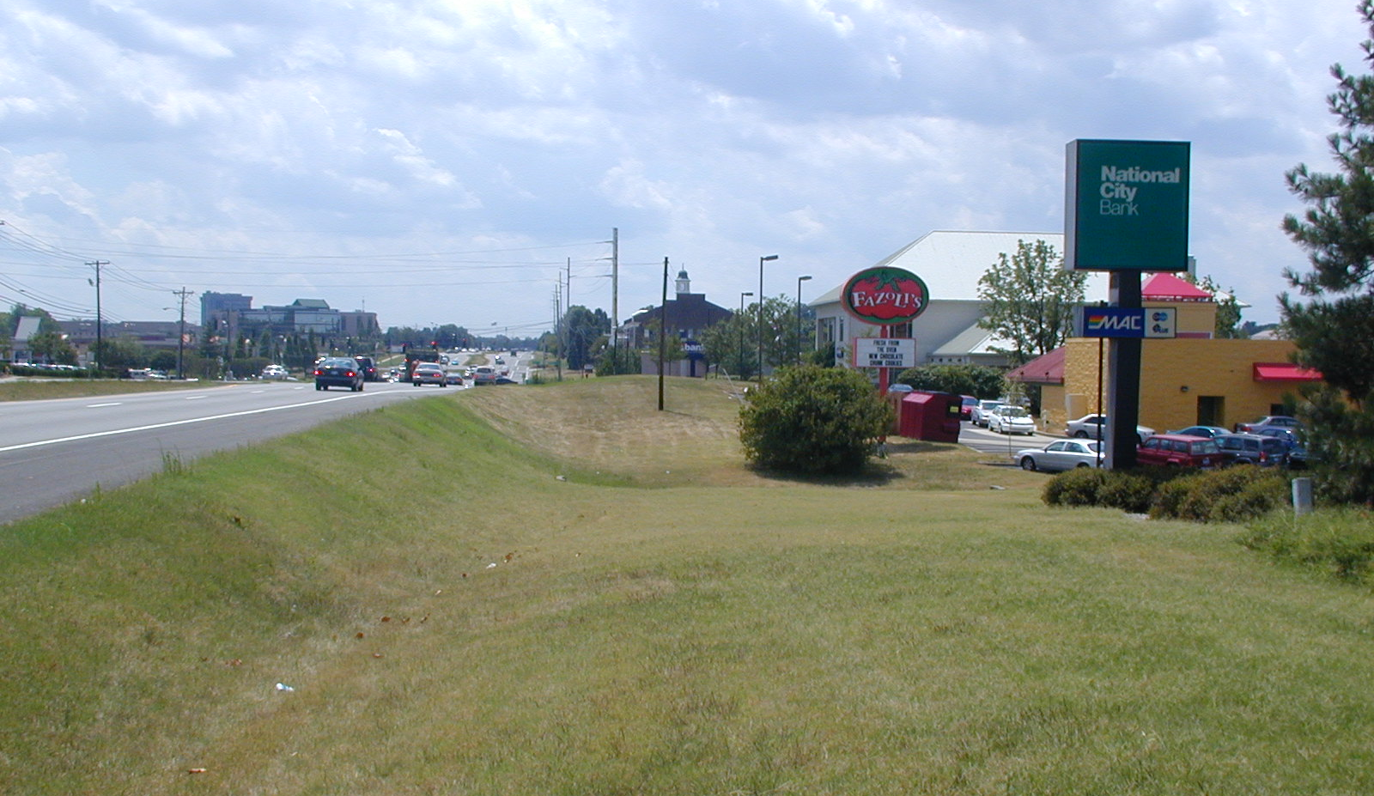
EXISTING CONDITIONS

Slide 9
PURPOSE AND NEED from 2008 Categorical Exclusion
Project Purpose
    Improve safety and reduce congestion in the 1.6 mile section of southbound Hurstbourne Parkway from Linn Station Road to the intersection with US 60.
Project Need
      The need for this project is demonstrated by high traffic volumes, existing traffic congestion (Level of Service F) and high accident rates in the project area. The project is also needed to meet state and local transportation planning goals.

Slide 10
FUNDING
Funding for this project is currently scheduled in the 2016-2022 Six-Year Plan at the following levels:
PROJECT: WIDEN SOUTHBOUND HURSTBOURNE LANE TO 3 LANES FROM LINN STATION RD TO EDEN AVE.
PHASE FUNDING FISCAL YEAR AMOUNT
RIGHT OF WAY SPP 2017 $ 2,960,000
UTILITIES SPP 2017 $ 3,140,000
CONSTRUCTION SPP 2018 $ 6,850,000*
$12,950,000
* Current construction cost is estimated at $5.1 million.

Slide 11
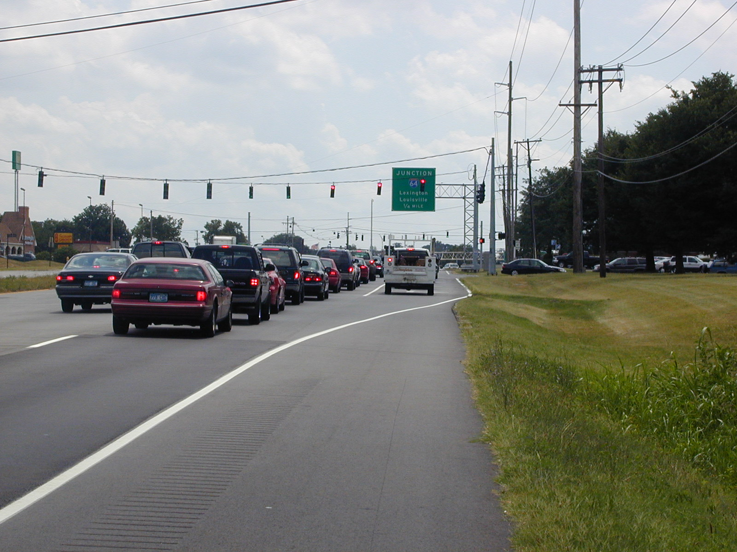
TRAFFIC
Average Daily Traffic in vehicles per day (from KIPDA website)
2015: 33,200 - 37,100
Average Daily Traffic in vehicles per day (from 2004 forecast)
2028: 45,600 - 48,100
%T: 8.9 - 9.3

Slide 12
2017 CRASH ANALYSIS
519 crashes from 2011 to 2015.
Developed crash diagrams for each intersection and applied Crash Modification Factors (CMFs) identified from the CMF clearinghouse.
Move southbound U-turn from Seaton Springs to Stone Creek Parkway and allowed left turns. This direct movement could reduce circuitous travel and reduce travel distances for U-turns originating from Wessex Place.
Reduce the large curb radius from eastbound Whittington Parkway to southbound Hurstbourne Lane to eliminate the appearance of a free flow right turn movement.

Slide 13
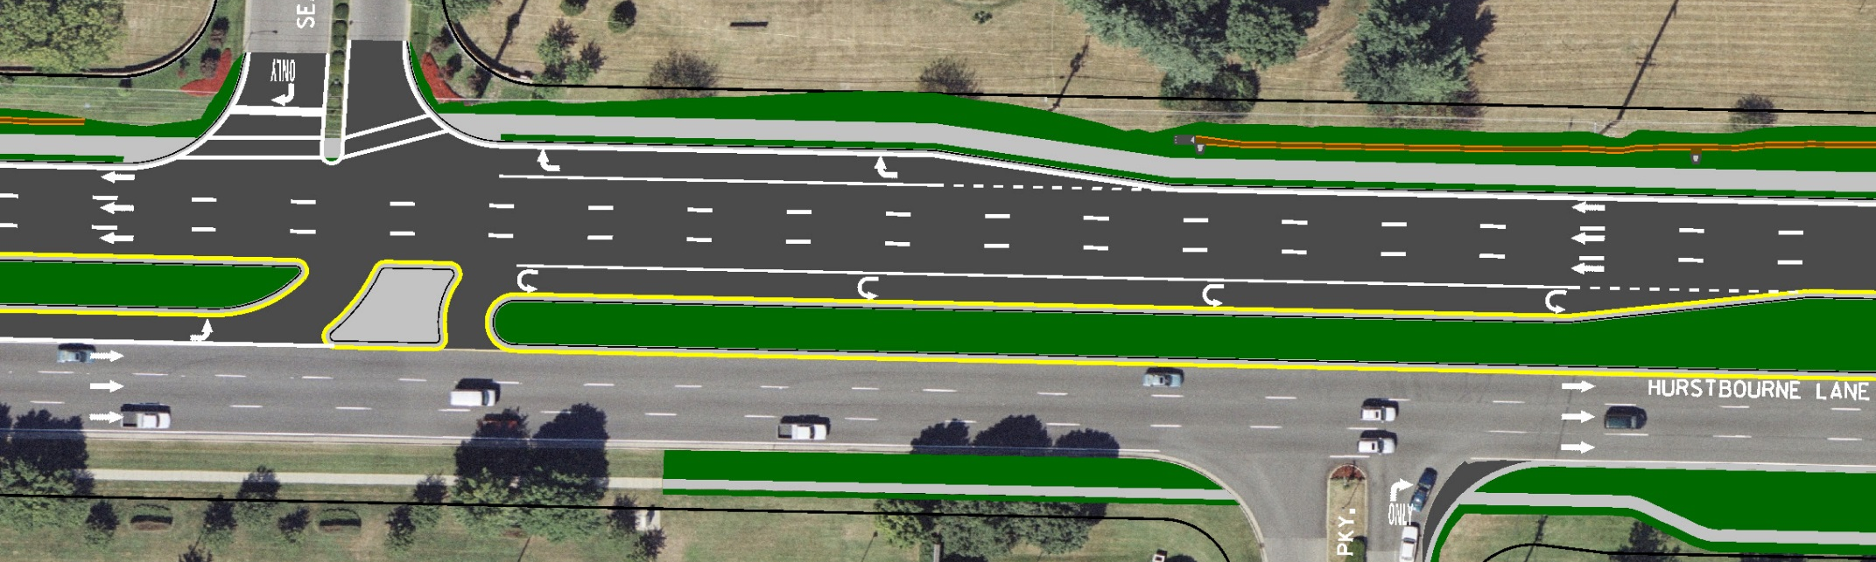
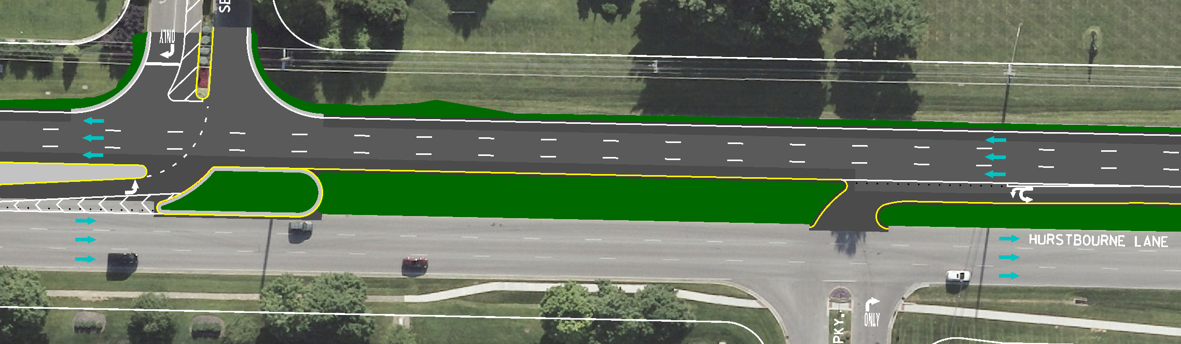
CRASH STUDY CHANGES
Previous Design
Current Design

Slide 14
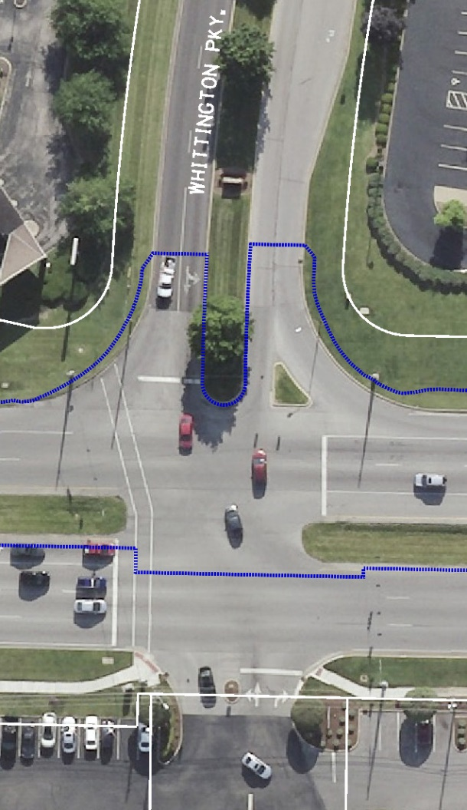
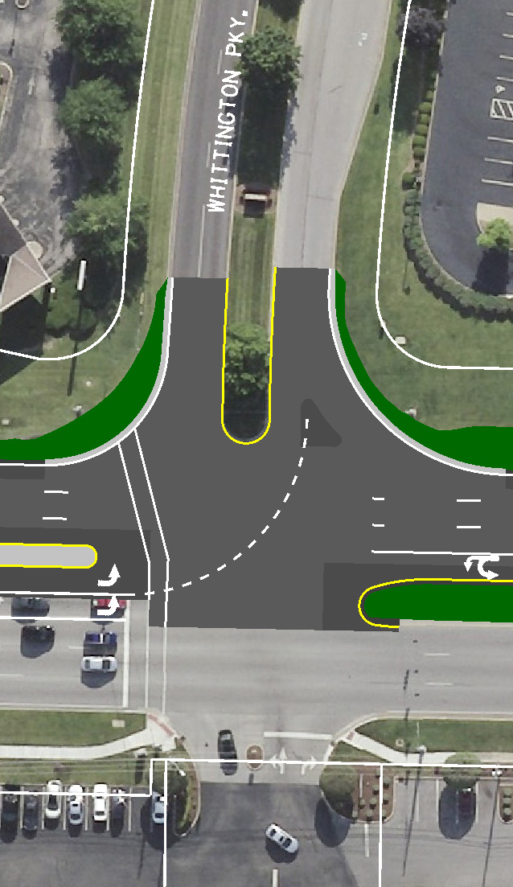
CRASH STUDY CHANGES
Existing
Current Design

Slide 15
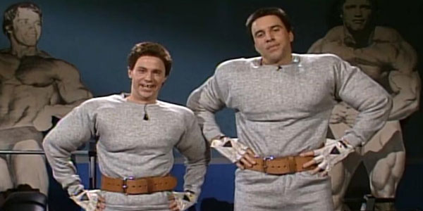
FLEX PROCESS
Preliminary Prioritization System score was favorable. Capacity and safety were identified as critical factors.
State Highway Engineer’s Office requested cost savings options be developed to reduce the total project costs as much as possible and advance the project to letting in 2017.
Environmental Document could be reevaluated to make the project eligible for Federal funding.
District 5 and GRW worked together to develop cost savings options.

Slide 16
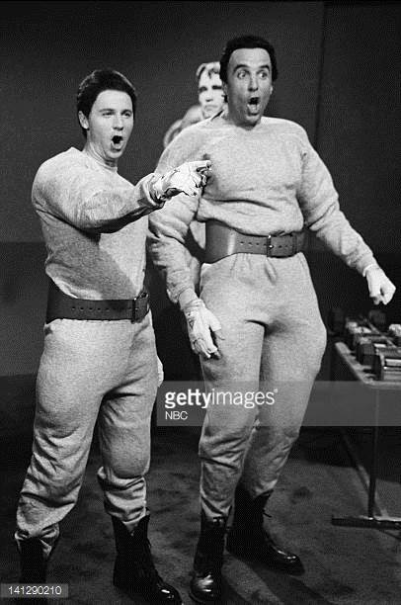
FLEX PROCESS
Cost Savings Options:
Reduce the Scope:
Adjust the project limits to end the project at the Shelbyville Road intersection, excluding 3-legs of improvements.
Remove access management component.

Slide 17
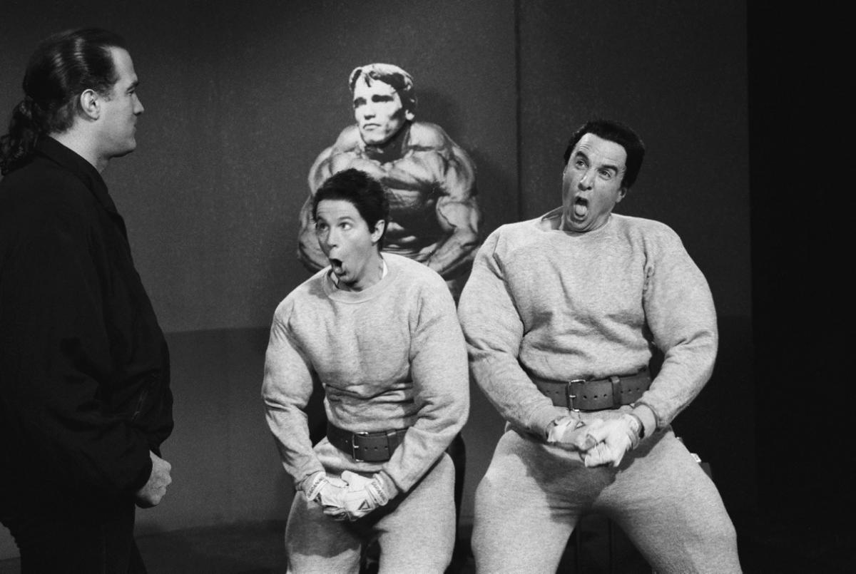
FLEX PROCESS
Cost Savings Options:
Revise the design:
Eliminate the sidewalk segments along the east side of the project.
Replace the urban curb, gutter and border with a rural paved shoulder.
Change the raised medians to depressed medians where possible.
Optimize the pavement design.

Slide 18
FLEX PROCESS
DESIGN CRITERIA | GUIDANCE MIN or MAX (Urban/Rural) | UNFLEXED (Urban) | FLEXED (Rural)
Design Speed (mph) | 45
Lane width (feet) | 11/12 | 11 | 11*
Shoulder width (ft.) | 8 (2 paved) | N/A | 4 (2 paved)*
Max. Grade (%) | 7.0 | 3.2% | 3.2%
Horiz. Radius (min. ft.) | 711 | 11,460 | 11,460
Stopping Sight Distance (ft.) | 360 | 436 | 436
Border Area (ft.) | 8 | 10 | N/A
* Two design variances will be needed.

Slide 19
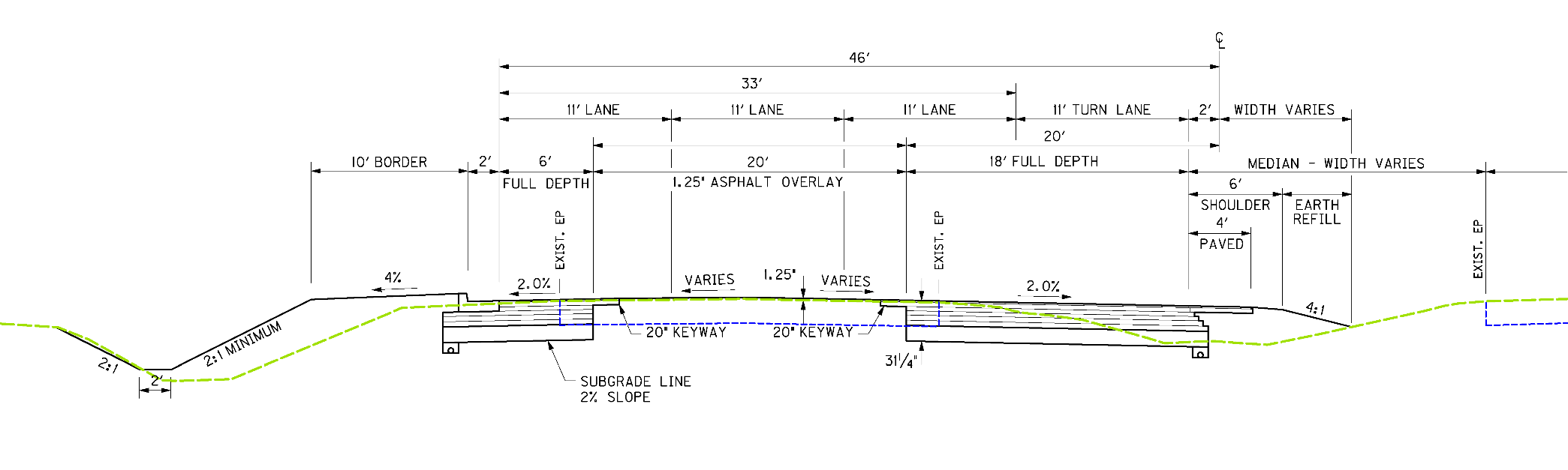
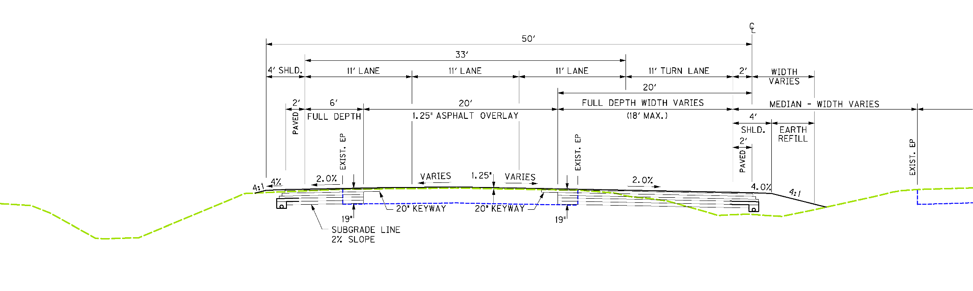
TYPICAL SECTIONS
UNFLEXED
FLEXED

Slide 20
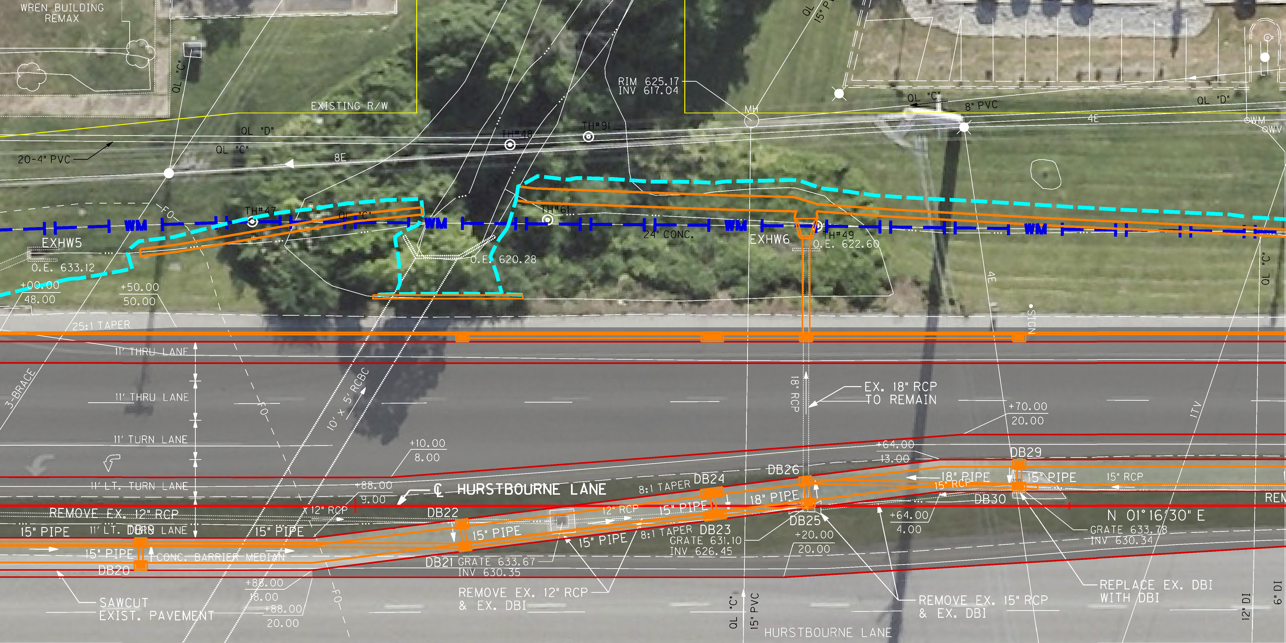
EXAMPLE DESIGN COMPARISON
UNFLEXED Design

Slide 21
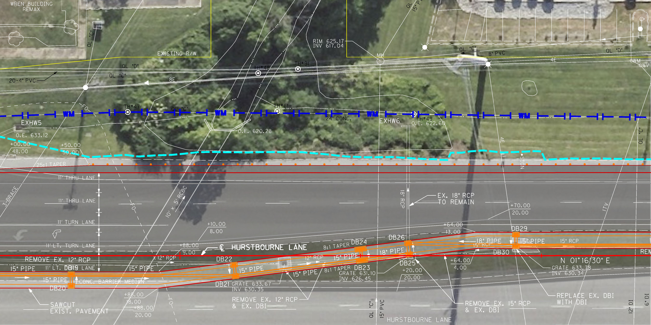
EXAMPLE DESIGN COMPARISON
FLEXED Design

Slide 22
FLEX RESULTS
Summary:
* Jeopardized fulfilling the project purpose and need and was considered
undesirable by the Project Team.
OPTION | DESCRIPTION | SAVINGS
A | Reduce Scope: Shelbyville Road Intersection | $800,000
B* | Reduce Scope: Access Management | $800,000
C | Revise Design: Eliminate east side sidewalk | $75,000
D | Revise Design: Urban to rural roadside design | $620,000
E | Revise Design: Raised to depressed median | $305,000
F | Revise Design: Optimize pavement design | TBD
TOTAL COST SAVINGS: |  | $1,800,000

Slide 23
FLEX RESULTS
Total Estimated Construction Cost Savings:
$1.8 MILLION
New total project construction cost: $3.3 million.
35% reduction

Slide 24
FLEX RESULTS
Total Estimated Project Funding Savings:
$8.6 MILLION
New total project cost: $4.3 million.
68% reduction

Slide 25
REASONS IT WORKED
Late in project development, but still time to implement changes and stay on schedule.
Scope was reduced, but still meets the purpose and need.
Existing rural features in a fully developed project corridor.
Wide existing right of way; No new right of way needed.
Minimizes utility impacts.
Design variances.

Slide 26
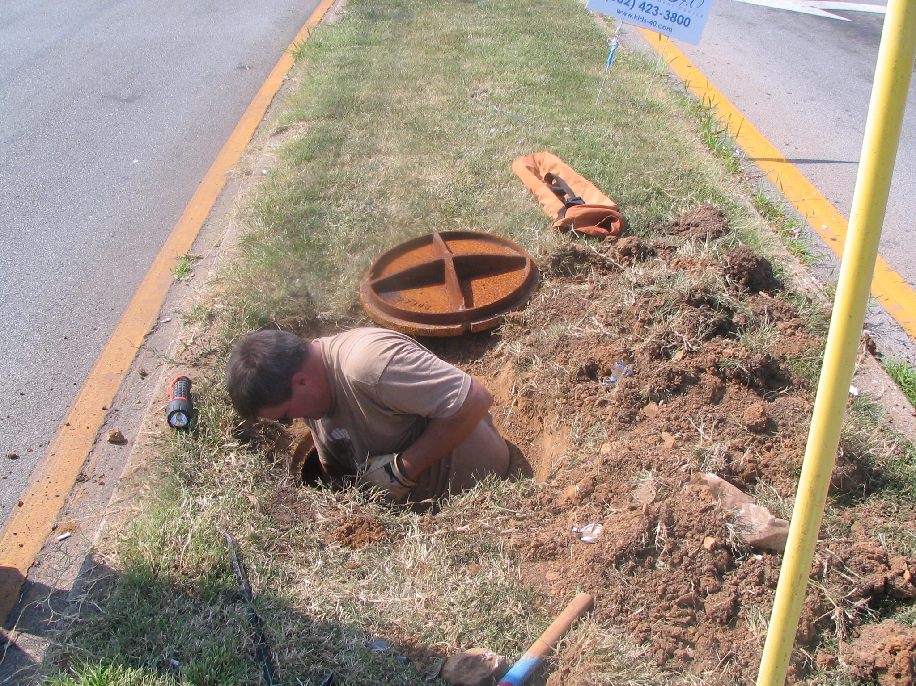
QUESTIONS/COMMENTS

